Slide 1
MTA-20438
PID

Slide 2
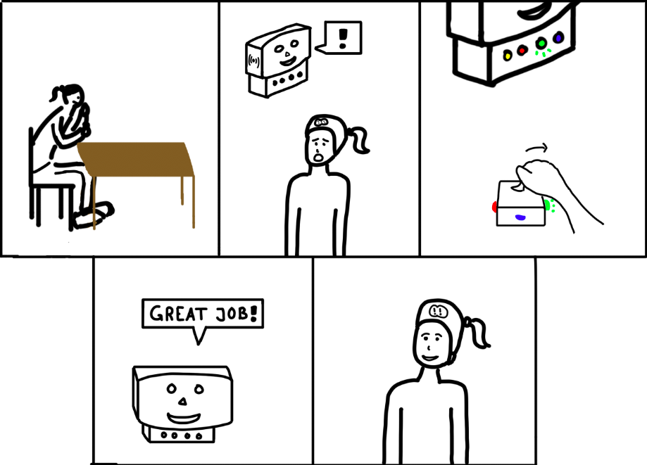
Improving hand-eye coordination with a game

Slide 3
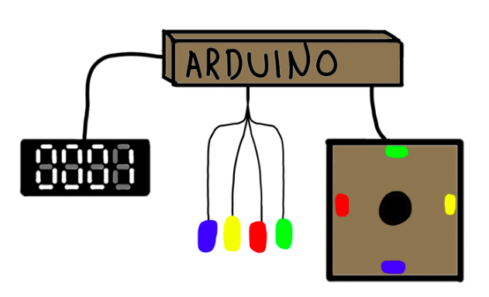
Notes:
Here we have the sketch for our idea

Slide 4
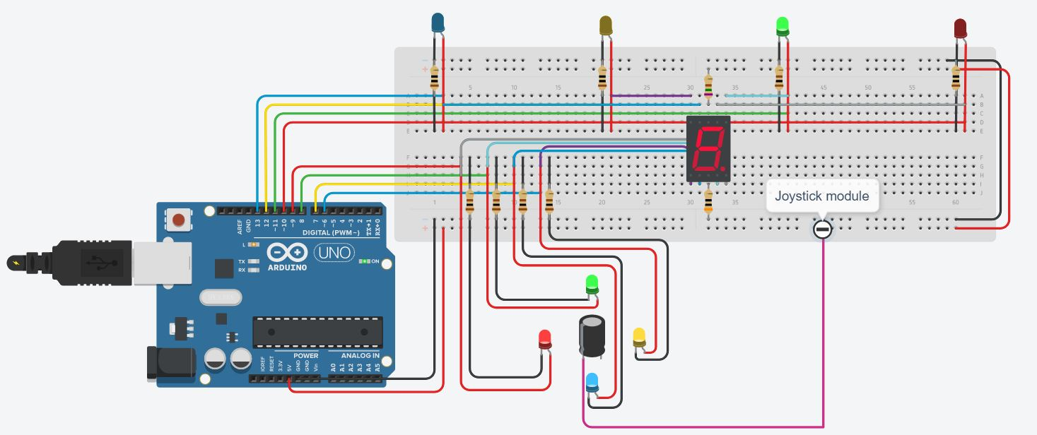
Circuit diagram
Notes:
Here we see our circuit diagram, which describes the prototype in more detail

Slide 5
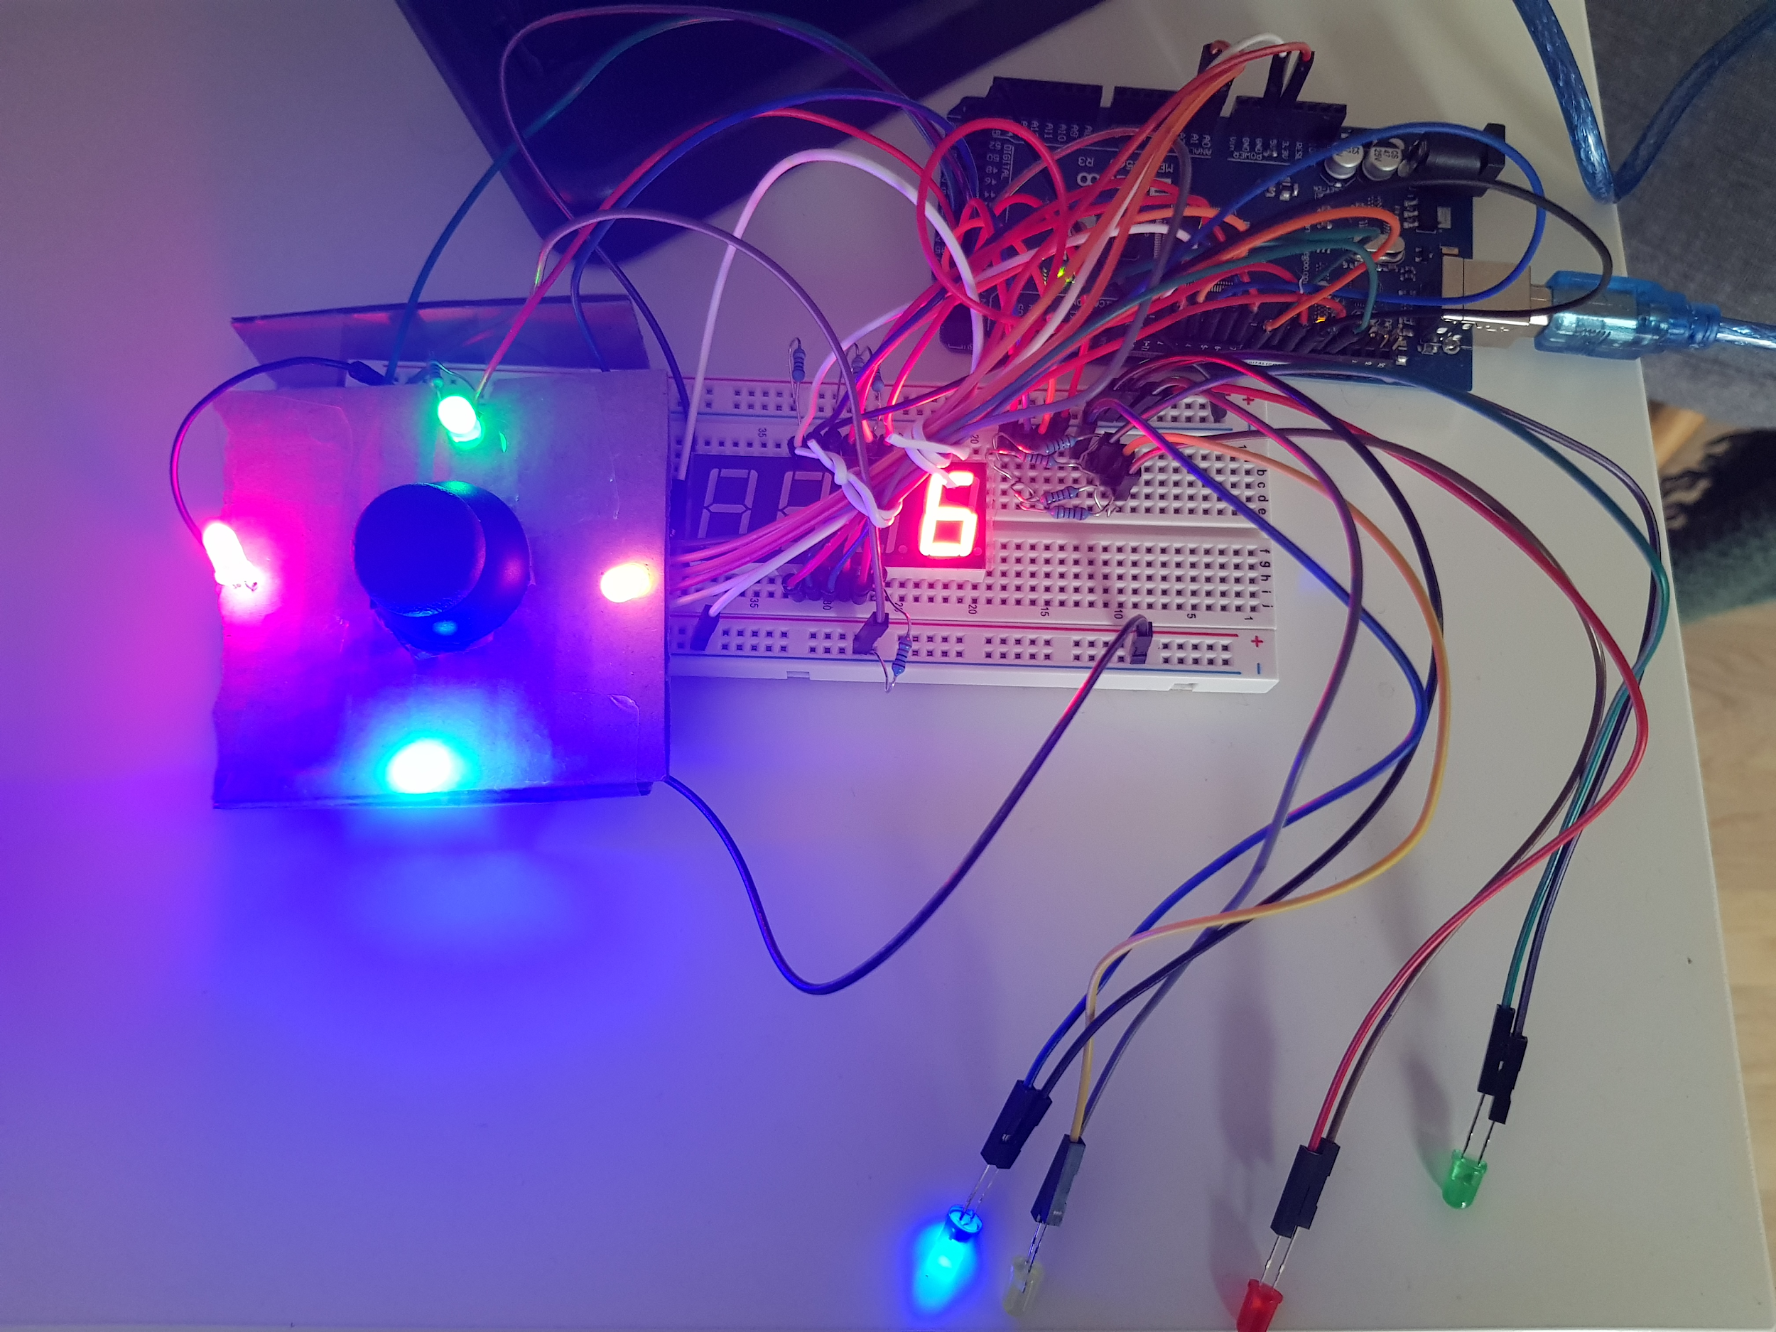

Slide 6
Demonstration of the Prototype
https://www.youtube.com/watch?v=KwtzAa93t0E

Slide 7
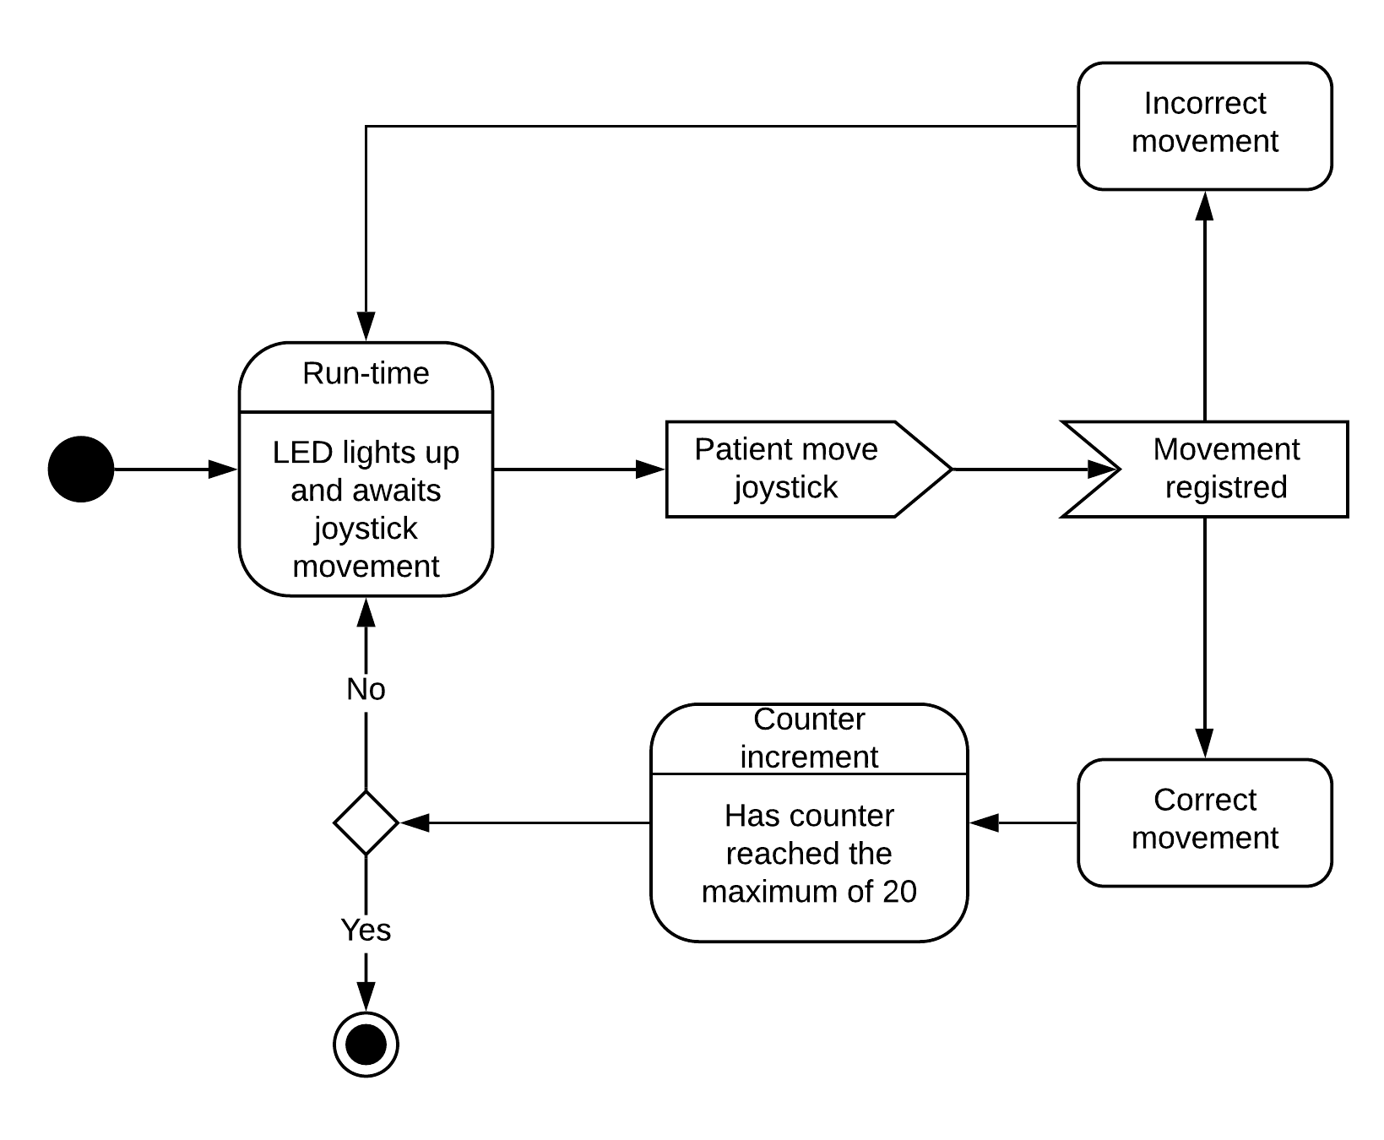
State
Action

Slide 8

State | Run-time
Affordance | Joystick movable in any direction, coloured LEDs in four directions surrounding joystick.
Signifier | LED light up to show which direction the joystick should be moved.
Feed-forward | Game explained by audio before movement.
Feedback | Number display incrementing, when correct movement of the joystick is made.
Indicator | LED turns off and a new LED lights up.
Notes:
Add images to show each of the states and then basically explain them as they stand here, with a bit different wording.

Slide 9
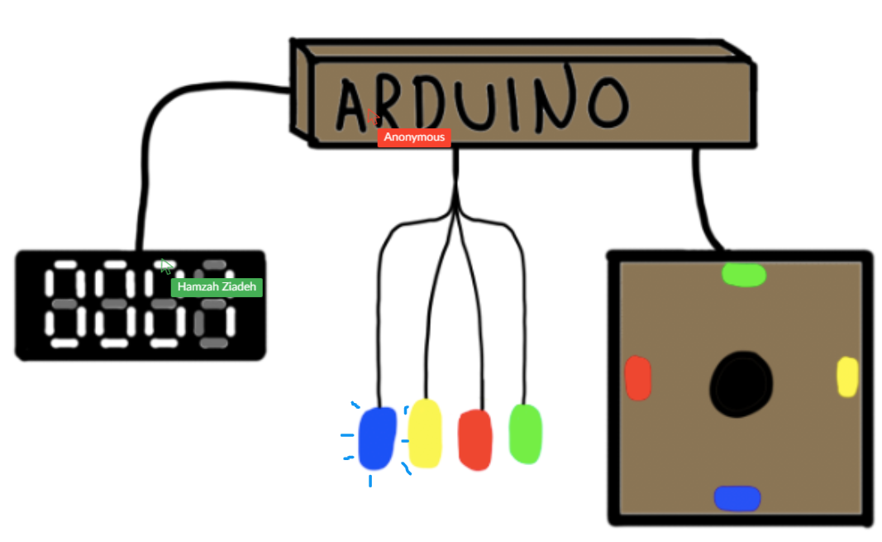
Mental Model - Setup
Interactive whiteboard
Discord
OBS
Notes:
Before the evaluation, we collected consent forms from all participants, a short manuscript for the interviewer was also created, to keep each of the interview processes as similar as possible. The evaluation was conducted online, through discord and an online whiteboard. We recorded it by open broadcaster service as well as took notes during the evaluation.
Firstly, we used the standard opener from Nicol, Gomoll. Afterwards we introduced the sketch (as seen here), where we explained what each of the parts are and then we asked them to go through it all and explain to us how they thought it was supposed to work together. If they had missed anything we would follow up with a few preplanned questions. Lastly, we asked them if they had anything they were uncertain of, or if they had anything they forgot to say or just thought of.

Slide 10
State | Run-time | Participants perceived | Feedback
Affordance | Joystick movable in any direction, coloured LEDs in four directions surrounding joystick. | Joystick movable in any direction, coloured LEDs in four directions surrounding joystick. | “What happens if I move diagonally?”
Signifier | LED light up to indicate which direction joystick should be moved. | LED light up to indicate which pattern the joystick should be moved. | Conflicted. Two participants would like the LEDs to be arranged in the same order on the joystick, Two like the fact that they are in different order.
Feed-forward | Game explained by audio before movement | None | Two participants thought that LEDs will turn on as a reaction when the joystick is moved.
Feedback | Number display incrementing, when correct movement of joystick is made. | Number display incrementing, when correct movement of joystick is made. Two participants unsure. | “If it’s meant to see how good your reflexes are then it’s more relevant to measure time, that’s more appropriate I think”
Indicator | LED shuts off and new LED light up. | LEDs light up in a new pattern | No comments. This part was clear for participants.

Slide 11
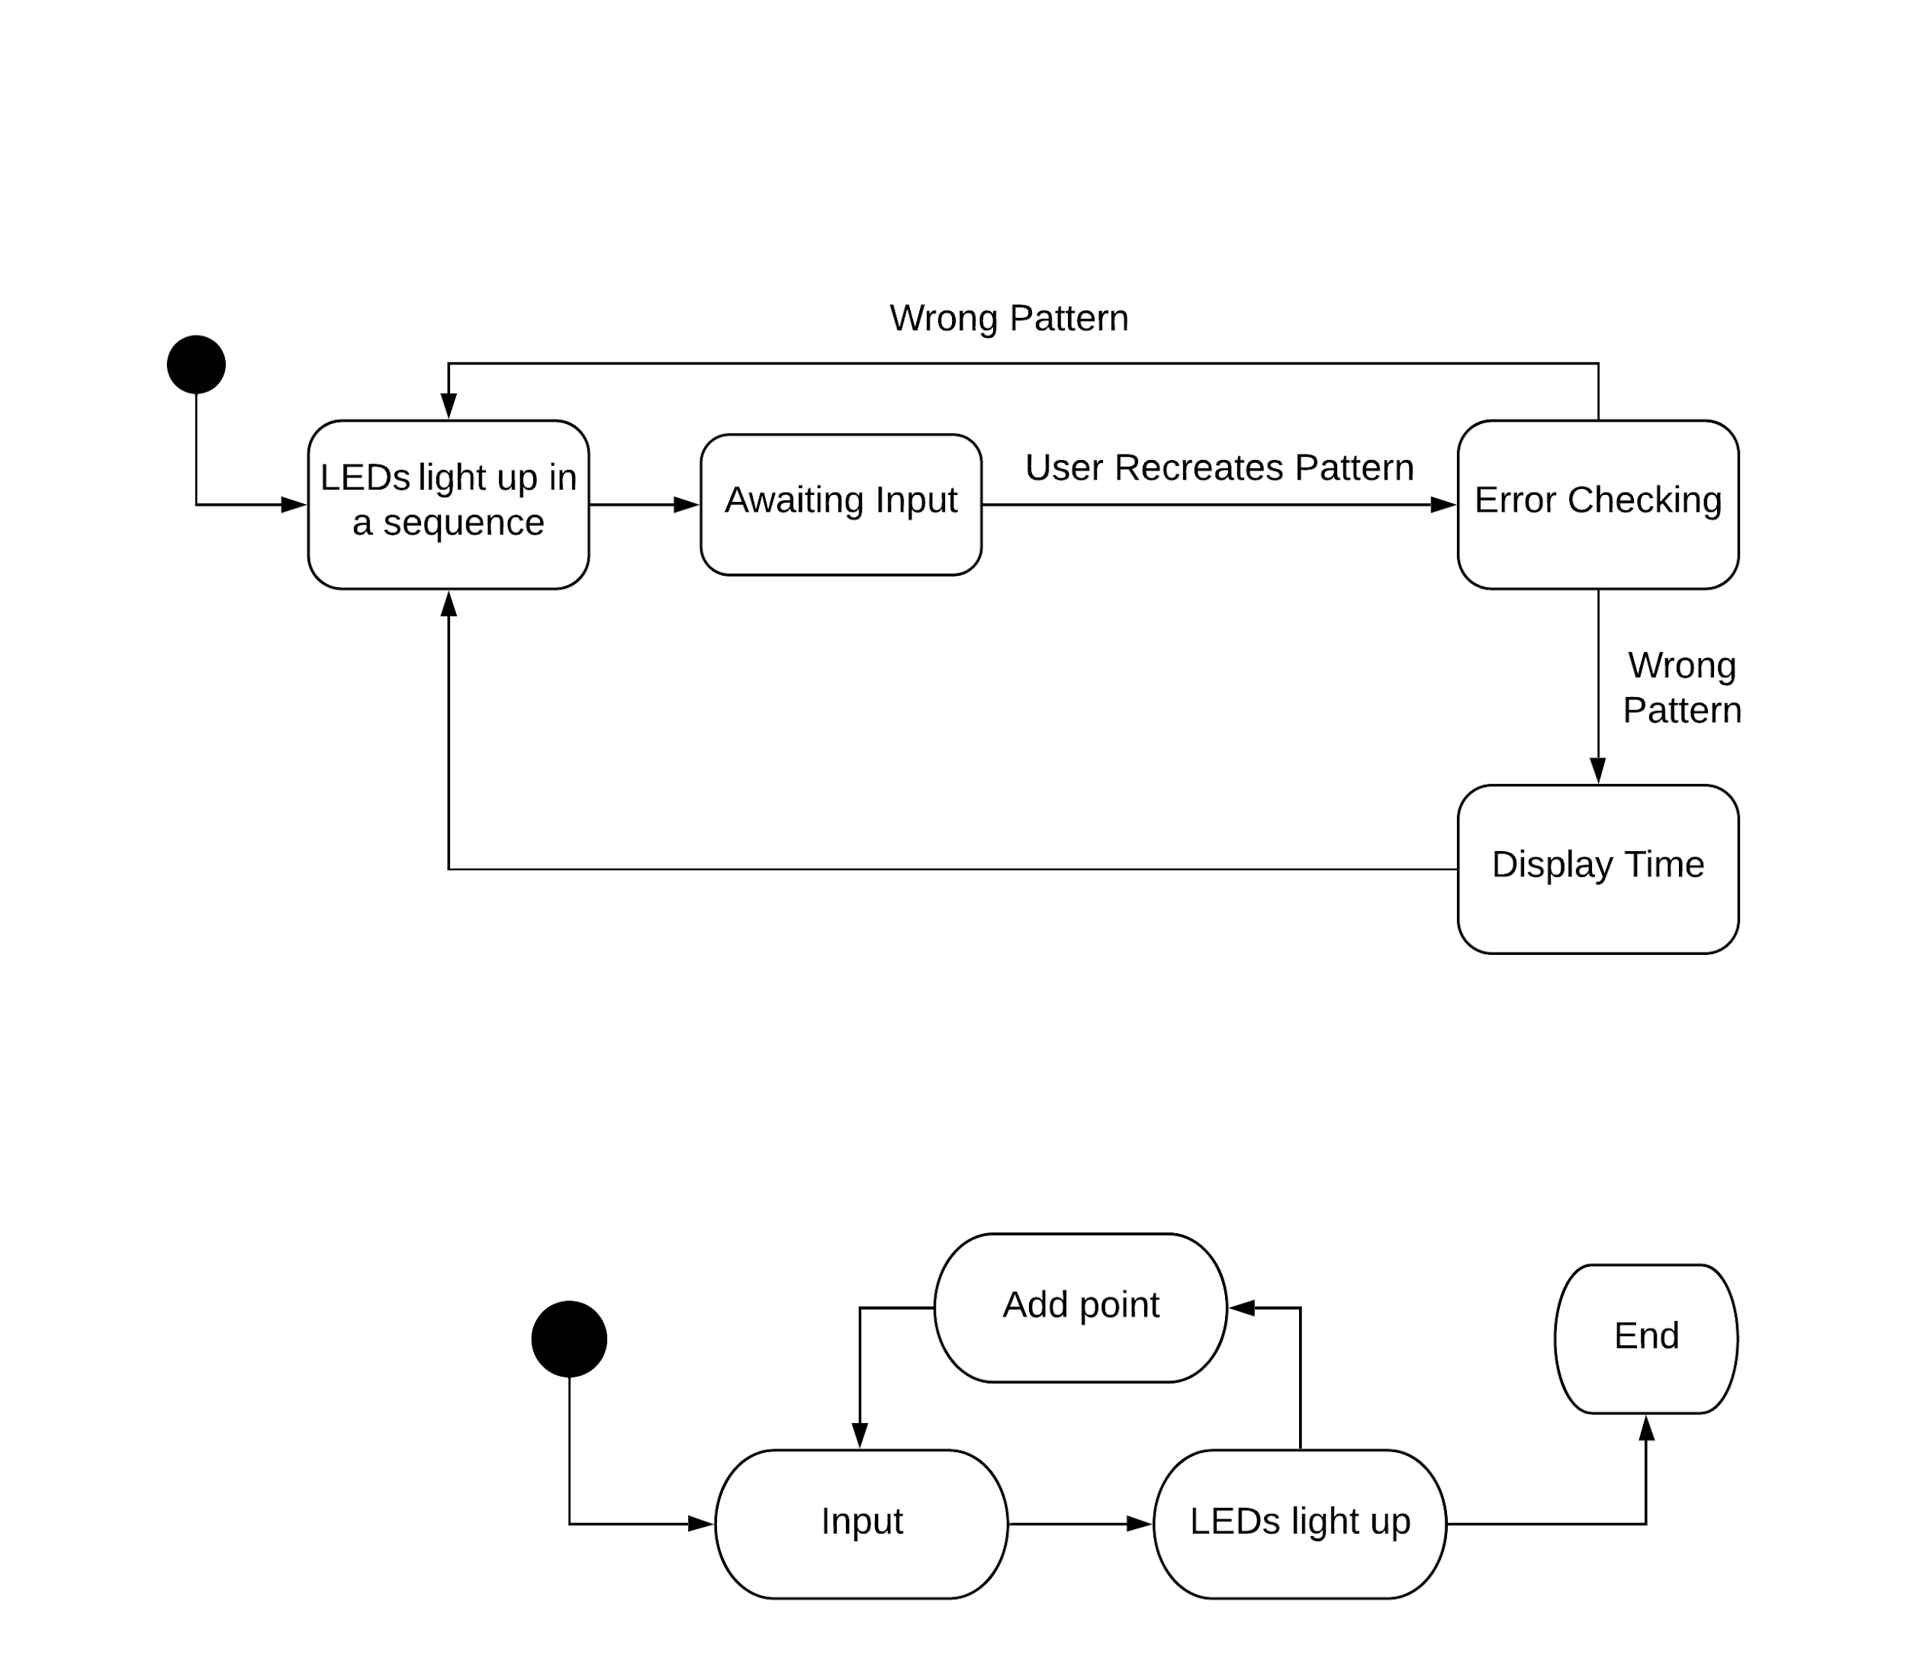
User Perceived state model charts
Intended state model chart

